Slide 1


Chapter 4
Lecture
Outline

Slide 2
Learning Outcomes
After studying this chapter, you should be able to answer the following questions:
•Why are we concerned about human population growth?
Will the world’s population triple in the twenty-first century as it did in the twentieth?
What is the relationship between population growth and environmental impact?
Why did human populations grow so rapidly in the last century?
How is human population growth changing in different parts of the world?
How does population growth change as a society develops?
What factors slow down or speed up human population growth?

Slide 3
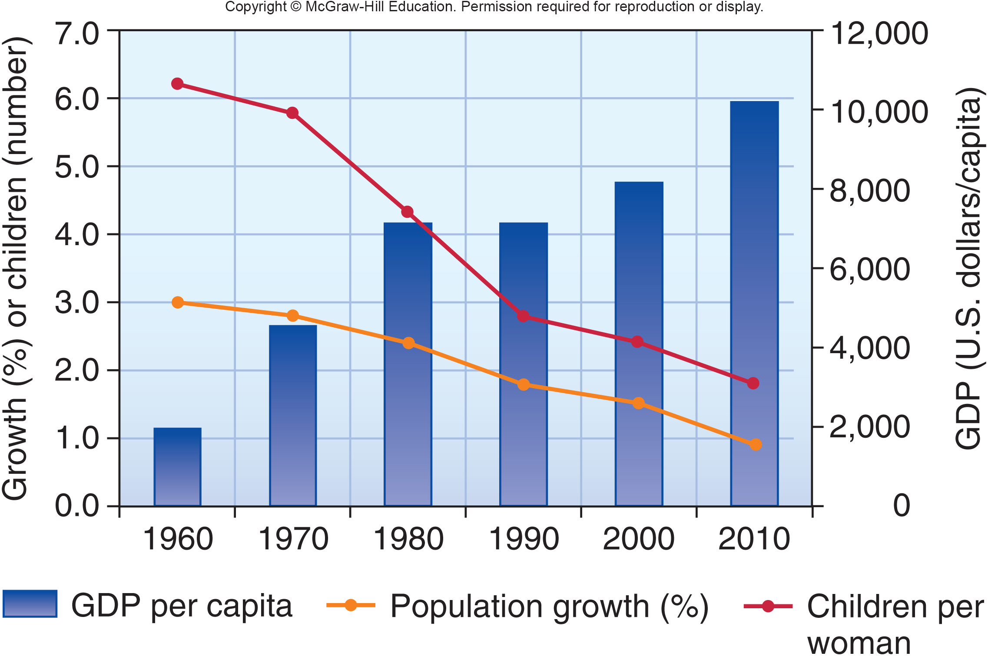
Case Study: Population Stabilization in Brazil
Notes:
In Brazil, a mix of economic growth, female empowerment, urbanization, and the widespread popularity of television and the images it portrays of modern life have resulted in one of the most abrupt birth rate declines over the past few decades of any country in the world.
Swift economic progress has brought a dramatically improved standard of living for most Brazilians. In 1960, the average wage in Brazil was less than $2,000 (U.S.) per year, only 19 percent of Brazilian households had electricity, TV was rare, the average education for females was 2 years, the typical woman had 6.2 children, and the annual population growth rate was 3.0 percent. Fifty years later, the average wage had risen fivefold, 95 percent of households had both electricity and TV, the average education for females was 8.6 years (a year more than for males), the fertility rate (number of children per woman in a lifetime) was 1.8, and the growth rate was 0.9 percent (fig. 4.1). Currently, 99 percent of urban residents have improved drinking water and 87 percent have improved sanitation. Infant mortality has fallen from 204 per 1,000 children in 1960 to 19 per 1,000 today. Knowing that your children are likely to survive to adulthood makes a big difference in how many you choose to have.
The industrialization that fueled this rapid economic growth also brought urbanization as people moved from rural areas to the cities in search of jobs. Currently 87 percent of Brazilians live in urban areas where smaller families are an economic advantage.
Recently, a program to extend electricity to remote rural areas and to the favelas (slums) that crowd the hills around major cities. As people moved to the city, they had both more access to TV and more leisure time. Daytime soap operas offered a view of what modern life might be like. Followed avidly by a majority of the population, the actors, plots, and situations in the telenovela were widely discussed and admired by the public. In general, the programs showed small, affluent , modern families with lots of material possessions. Women in particular are shown as powerful executives and business owners who have successful careers and considerable personal freedom. This image has changed aspirations for many women. The desire to have large families, as their mothers or grandmothers did, is no longer popular among young women. No official government policy in Brazil has ever promoted family planning. The country is overwhelmingly Roman Catholic (with the largest catholic population in world), but most women quietly chose to ignore church teaching about birth control.
So, Brazil has stabilized its population without direct intervention in family planning. Economic growth, better educational opportunities for girls, women’s rights, and a vision of what life could hold for a modern family have brought about this change spontaneously.
3

Slide 4
4.1 Past and Current Population
Growth are Very Different
Every second, on average, four or five children are born, somewhere on the earth. In that same second, one or two other people die.
In 2011 the United Nations announced that we had reached 7 billion people, having added the most recent billion in only 12 years. We’re now growing at 1.1 percent per year.
Whether human populations will continue to grow at present rates and what this would imply for environmental quality and human life are among the most central questions in environmental science.
Notes:
Every second, on average, four or five children are born somewhere on the earth. In that same second, one or two other people die. This difference between births and deaths means a net gain of about 2.5 more humans per second (on average) in the world’s population. In 2011 the United Nations announced that we had reached 7 billion people, having added the most recent billion in only 12 years. We’re now growing at 1.11 percent per year. This means we are adding about 75 million more people to the planet every year.
Many people worry that overpopulation will cause—or perhaps already is causing—resource depletion and environmental degradation that threaten the ecological life-support systems on which we all depend. Others believe that human ingenuity, technology, and enterprise can expand the world’s carrying capacity and allow us to overcome any problems we encounter. From this perspective, more people may be beneficial, rather than disastrous.
Whether human populations will continue to grow at present rates and what that growth would imply for environmental quality and human life are among the most central and pressing questions in environmental science.
4

Slide 5

Human Populations Grew
Slowly Until Recently
For most of our history, humans were not very numerous.
Populations of early hunting and gathering societies probably numbered only a few million before the invention of agriculture 10,000 years ago.
Notes:
The agricultural revolution produced a larger and more secure food supply and allowed the human population to grow, reaching perhaps 50 million people by 5000 B.C.. For thousands of years, the number of humans increased very slowly. Archaeological evidence and historical descriptions suggest that only about 300 million people were living in the first century A.D. (table 4.1).
5

Slide 6
Human Population Increases are Relatively Recent
As you can see in figure 4.3, human populations began to increase rapidly after about A.D. 1600.
It only took 156 more years to get to 3 billion in 1960.
It took us about 12 years to add the seventh billion.
The number of living humans tripled during the twentieth century.
Will it do so again in the twenty-first century?
Will we reach equilibrium soon enough and at a size that can be sustained over the long term?
Notes:
Many factors contributed to this rapid growth seen after 1600 AD. Increased sailing and navigating skills stimulated commerce and communication among nations. Agricultural developments, better sources of power, and improved health care and hygiene also played a role. We are now in an exponential, or J curve, pattern of growth, described in chapter 3. It took all of human history to reach 1 billion people in 1800 but only 156 more years to get to 3 billion in 1960. It took us about 12 years to add the seventh billion. Another way to look at population growth is that the number of living humans tripled during the twentieth century. Will it do so again in the twenty-first century? If it does, will we overshoot our environment’s carrying capacity and experience a catastrophic dieback similar to those described in chapter 3? As you will see later in this chapter, there is some evidence that population growth already is slowing, but whether we will reach equilibrium soon enough and at a size that can be sustained over the long term remains a difficult but vital question.
6

Slide 7
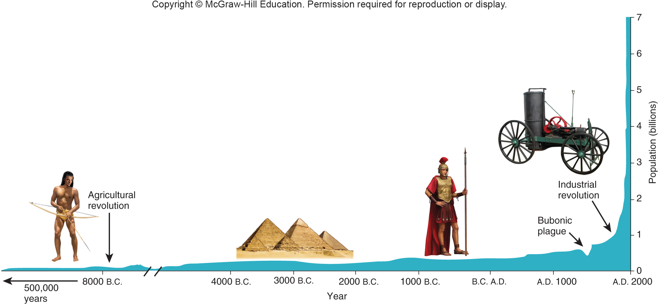
Human Populations Throughout History

Slide 8
World Population Growth and
Doubling Times
TABLE 4.1 World Population Growth and Doubling Times
DATE | POPULATION | DOUBLING TIME
5000 B.C. | 50 million | ?
800 B.C. | 100 million | 4,200 years
200 B.C. | 200 million | 600 years
A.D. 1200 | 400 million | 1,400 years
A.D. 1700 | 800 million | 500 years
A.D. 1900 | 1,600 million | 200 years
A.D. 1965 | 3,200 million | 65 years
A.D. 2000 | 6,100 million | 51 years
A.D. 2050 (estimate) | 8,920 million | 215 years
SOURCE: United Nations Population Division.

Slide 9
Today, Access to Birth Control Affects the Number of Children Families Have
Notes:
The number of children a family chooses to have is determined by many factors. In urban, industrialized countries, such as Brazil, most families now want only one or two children.

Slide 10
4.2 Perspectives on Population Growth
As with many topics in environmental science, people have widely differing opinions about population and resources.
Some believe that population growth is the ultimate cause of poverty and environmental degradation.
Others argue that poverty, environmental degradation, and overpopulation are all merely symptoms of deeper social and political factors.
The worldview we choose to believe will profoundly affect our approach to population issues.
Notes:
10

Slide 11
Does Environment or Culture Control Human Population Growth?
Since the time of the Industrial Revolution, individuals have argued about the causes and consequences of population growth.
In 1798, Thomas Malthus hypothesized that human populations would outstrip their food supply and collapse into starvation, crime, and misery.
A few decades later, Karl Marx presented an opposing view, that population growth resulted from poverty, resource depletion, pollution, and other social ills.
Notes:
In 1798 Thomas Malthus (1766–1834) wrote An Essay on the Principle of Population, changing the way European leaders thought about population growth. Malthus collected data to show that populations tended to increase at an exponential, or compound, rate, whereas food production either remained stable or increased only slowly. Eventually, he argued, human populations would outstrip their food supply and collapse into starvation, crime, and misery.
The economist Karl Marx (1818–1883) presented an opposing view that population growth results from poverty, resource depletion, pollution, and other social ills. Slowing population growth, claimed Marx, requires that people be treated justly, and that exploitation and oppression be eliminated from social arrangements. Both Marx and Malthus developed their theories about human population growth when the world, technology, and society were understood much differently from how they are today. Some believe that we are approaching, or may have surpassed, the earth’s carrying capacity.

Slide 12
What is the Carrying Capacity for Humans?
Some believe that we are approaching, or may have surpassed, the earth’s carrying capacity.
Joel Cohen, at Rockefeller University reviewed published estimates of the maximum human population size the planet can sustain. The estimates, spanning 300 years of thinking, converged on a median value of 10–12 billion.
David Pimental from Cornell University states that “By 2100, if current trends continue, 12 billion miserable humans will suffer a difficult life on Earth.”

Slide 13
Technology Increases Carrying
Capacity for Humans (1)
Optimists argue that Malthus was wrong in his predictions of famine and disaster 200 years ago because he failed to account for scientific and technical progress.
Since then, progress in agricultural productivity, engineering, information technology, commerce, medicine, and sanitation, have made it possible to support approximately 1,000 times as many people per unit area as was possible 10,000 years ago.
Will we continue to find technological solutions?
Notes:
The burst of world population growth that began 200 years ago was stimulated by scientific and industrial revolutions. Progress in agricultural productivity, engineering, information technology, commerce, medicine, sanitation, and other achievements of modern life have made it possible to support approximately 1,000 times as many people per unit area as was possible 10,000 years ago. Economist Stephen Moore of the Cato Institute in Washington, D.C., regards this achievement as “a real tribute to human ingenuity and our ability to innovate.” There is no reason, he argues, to think that our ability to find technological solutions to our problems will diminish in the future.
13

Slide 14

Technology Increases Carrying
Capacity for Humans (2)

Slide 15
Calculating the Impact of Human Population
Our environmental effects aren’t just a matter of population size; they also depend on what kinds of resources we use and how we use them.
This concept is summarized as the I = PAT formula. Our environmental impacts (I) are the product of our population size (P) times affluence level (A) and the technology level (T).
A family living an affluent lifestyle in the U.S. could cause greater environmental damage than a whole village of African hunters and gatherers.
Notes:
While increased standards of living in Brazil have helped stabilize population, they also bring about higher technological impacts. A family living an affluent lifestyle that depends on high levels of energy and material consumption, and that produces excessive amounts of pollution, could cause greater environmental damage than a whole village of hunters and gatherers or subsistence farmers. Put another way, if the billions of people in Asia, Africa, and Latin America were to reach the levels of consumption now enjoyed by rich people in North America or Europe using the same technology that provides that lifestyle today, the environmental effects will undoubtedly be disastrous.
15

Slide 16
Ecological Footprints Can Calculate Impact
Another way to estimate our environmental impacts is to express our consumption choices into the equivalent amount of land required to produce goods and services.
This gives us a single number, called our ecological footprint, which estimates the relative amount of productive land required to support each of us.
For example, forests and grasslands store carbon, protect watersheds, purify our water, and provide wildlife habitat.
Notes:
Services provided by nature make up a large proportion of our ecological footprint. For example, forests and grasslands store carbon, protect watersheds, purify air and water, and provide wildlife habitat.
16

Slide 17
Population Growth Could Bring Benefits
More people means larger markets, more workers, and efficiencies of scale in mass production of goods.
It also means more people to find new resources and better solutions to problems.
Economist Julian Simon believed that people are the “ultimate resource” and that no evidence shows that pollution, crime, unemployment, crowding, the loss of species, or any other resource limitations will worsen with population growth.
Notes:
Adding people also boosts human ingenuity and intelligence that can create new resources by finding new materials and discovering new ways of doing things.
17

Slide 18
4.3 Many Factors Determine
Population Growth
Demography encompasses vital statistics about people, such as births, deaths, and where they live, as well as total population size.
In this section, we will investigate ways to measure and describe human populations and discuss demographic factors that contribute to population growth.
Notes:
18

Slide 19
How Many of Us are There?
The United Nations estimate of 7 billion people in 2011 is only an estimate. Even in this age of information technology and advanced communication, counting the number of people in the world is an inexact science.
We really live in two very different demographic worlds. One of these worlds is poor, young, and growing rapidly, while the other is rich, old, and shrinking in population size.
Notes:
Some countries have never even taken a census, and some that have been done may not be accurate. Governments overstate or understate their populations to make their countries appear larger and more important or smaller and more stable than they really are. Some individuals, especially if they are homeless, refugees, or illegal aliens, may not want to be counted or identified.

Slide 20
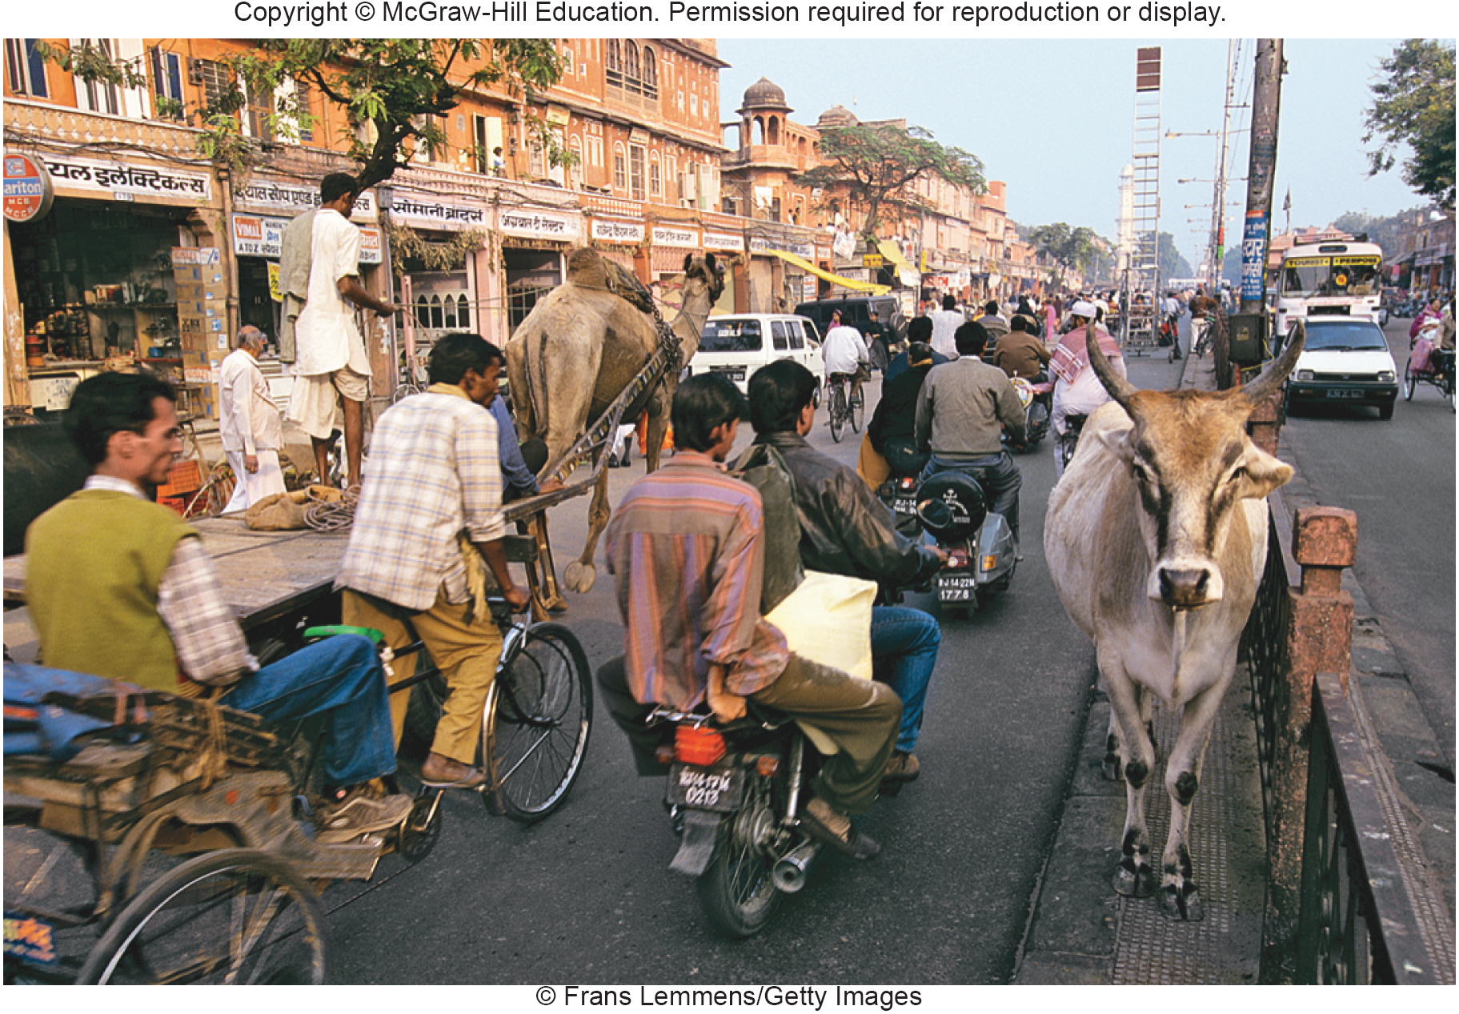
We Live in a Demographically Divided World
Notes:
We really live in two very different demographic worlds. One of these worlds is poor, young, and growing rapidly, while the other is rich, old, and shrinking in population size. The poorer world is occupied by the vast majority of people who live in the less-developed countries of Africa, Asia, and Latin America (fig. 4.6). These countries represent 80 percent of the world population but will contribute more than 90 percent of all projected future growth. The richer world is made up of North America, western Europe, Japan, Australia, and New Zealand.
20

Slide 21
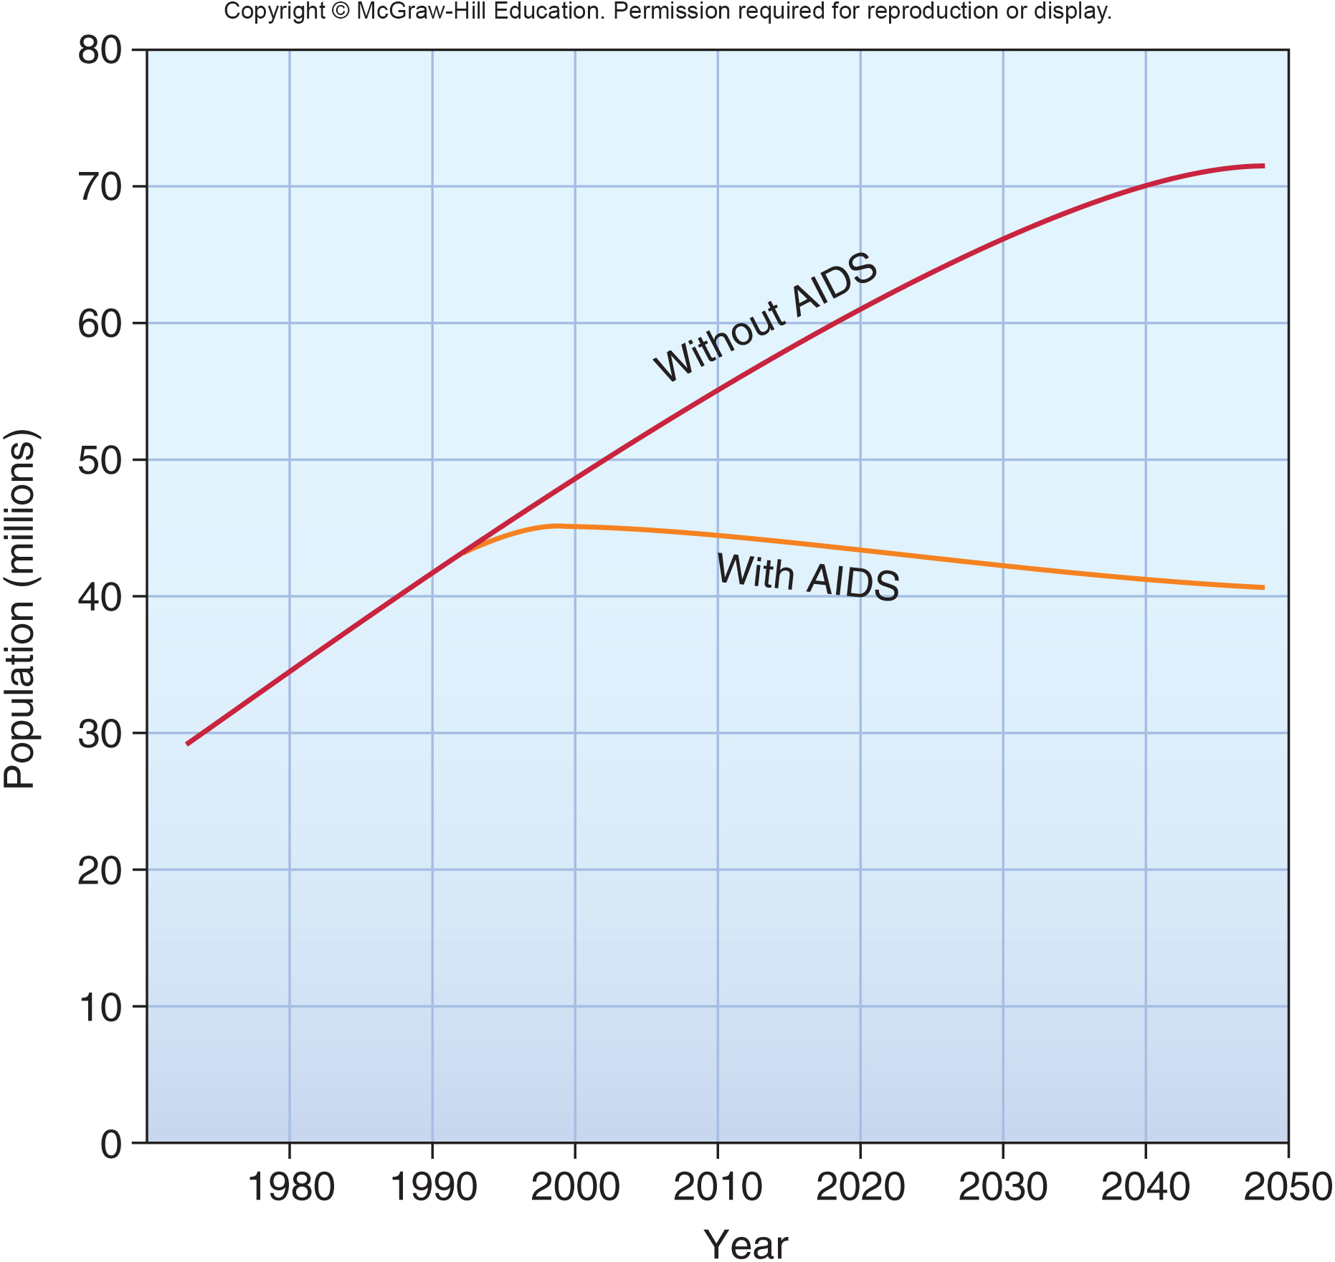
AIDS Affects Population Growth Rates
In Zimbabwe, Botswana, Zambia, and Namibia, up to 39% of the adult population have AIDS or are HIV positive.
Without AIDS, the average life expectancy would have been nearly 70 years. Now, with AIDS, life expectancy has dropped to only 31.6 years.
Notes:
The situation is even worse in many African countries, where AIDS and other communicable diseases are killing people at a terrible rate. The populations of many African countries are now falling because of this terrible disease (fig. 4.7). Altogether, Africa’s population is expected to be nearly 200 million lower in 2050 than it would have been without AIDS.
21

Slide 22
Factors Affecting Population Growth
Fertility varies among cultures and at different times.
Mortality offsets births.
Life expectancy is rising worldwide.
Living longer has profound social implications.
Notes:
Although the world as a whole still has an average fertility rate of 2.5, growth rates are lower now than at any time since World War II. If fertility declines like those in Brazil were to occur everywhere in the world, our total population could begin to decline by the end of the twenty-first century.
Rapidly growing, developing countries, such as Brazil, often have lower crude death rates (6 per 1,000 currently) than do the more-developed, slowly growing countries, such as Denmark (12 per 1,000), even though their life expectancies are considerably lower. This is because a rapidly growing country has proportionately more youths and fewer elderly than a more slowly growing country
For most of human history, life expectancy in most societies probably has been 35 to 40 years. This means, not that no one lived past age 40, but instead that many people died at earlier ages (mostly early childhood), which balanced out those who managed to live longer. The twentieth century saw a global transformation in human health unmatched in history. This revolution can be seen in the dramatic increases in life expectancy in most places.
In 1950 there were only 130 million people in the world over 65 years old. In 2012 more than 540 million had reached this age. By 2050, the UN predicts, there will be two older persons for every child in the world. Countries such as Japan, France, and Germany already are concerned that they don’t have enough young people to fill jobs and support their retirement system. They are encouraging couples to have more children.
22

Slide 23
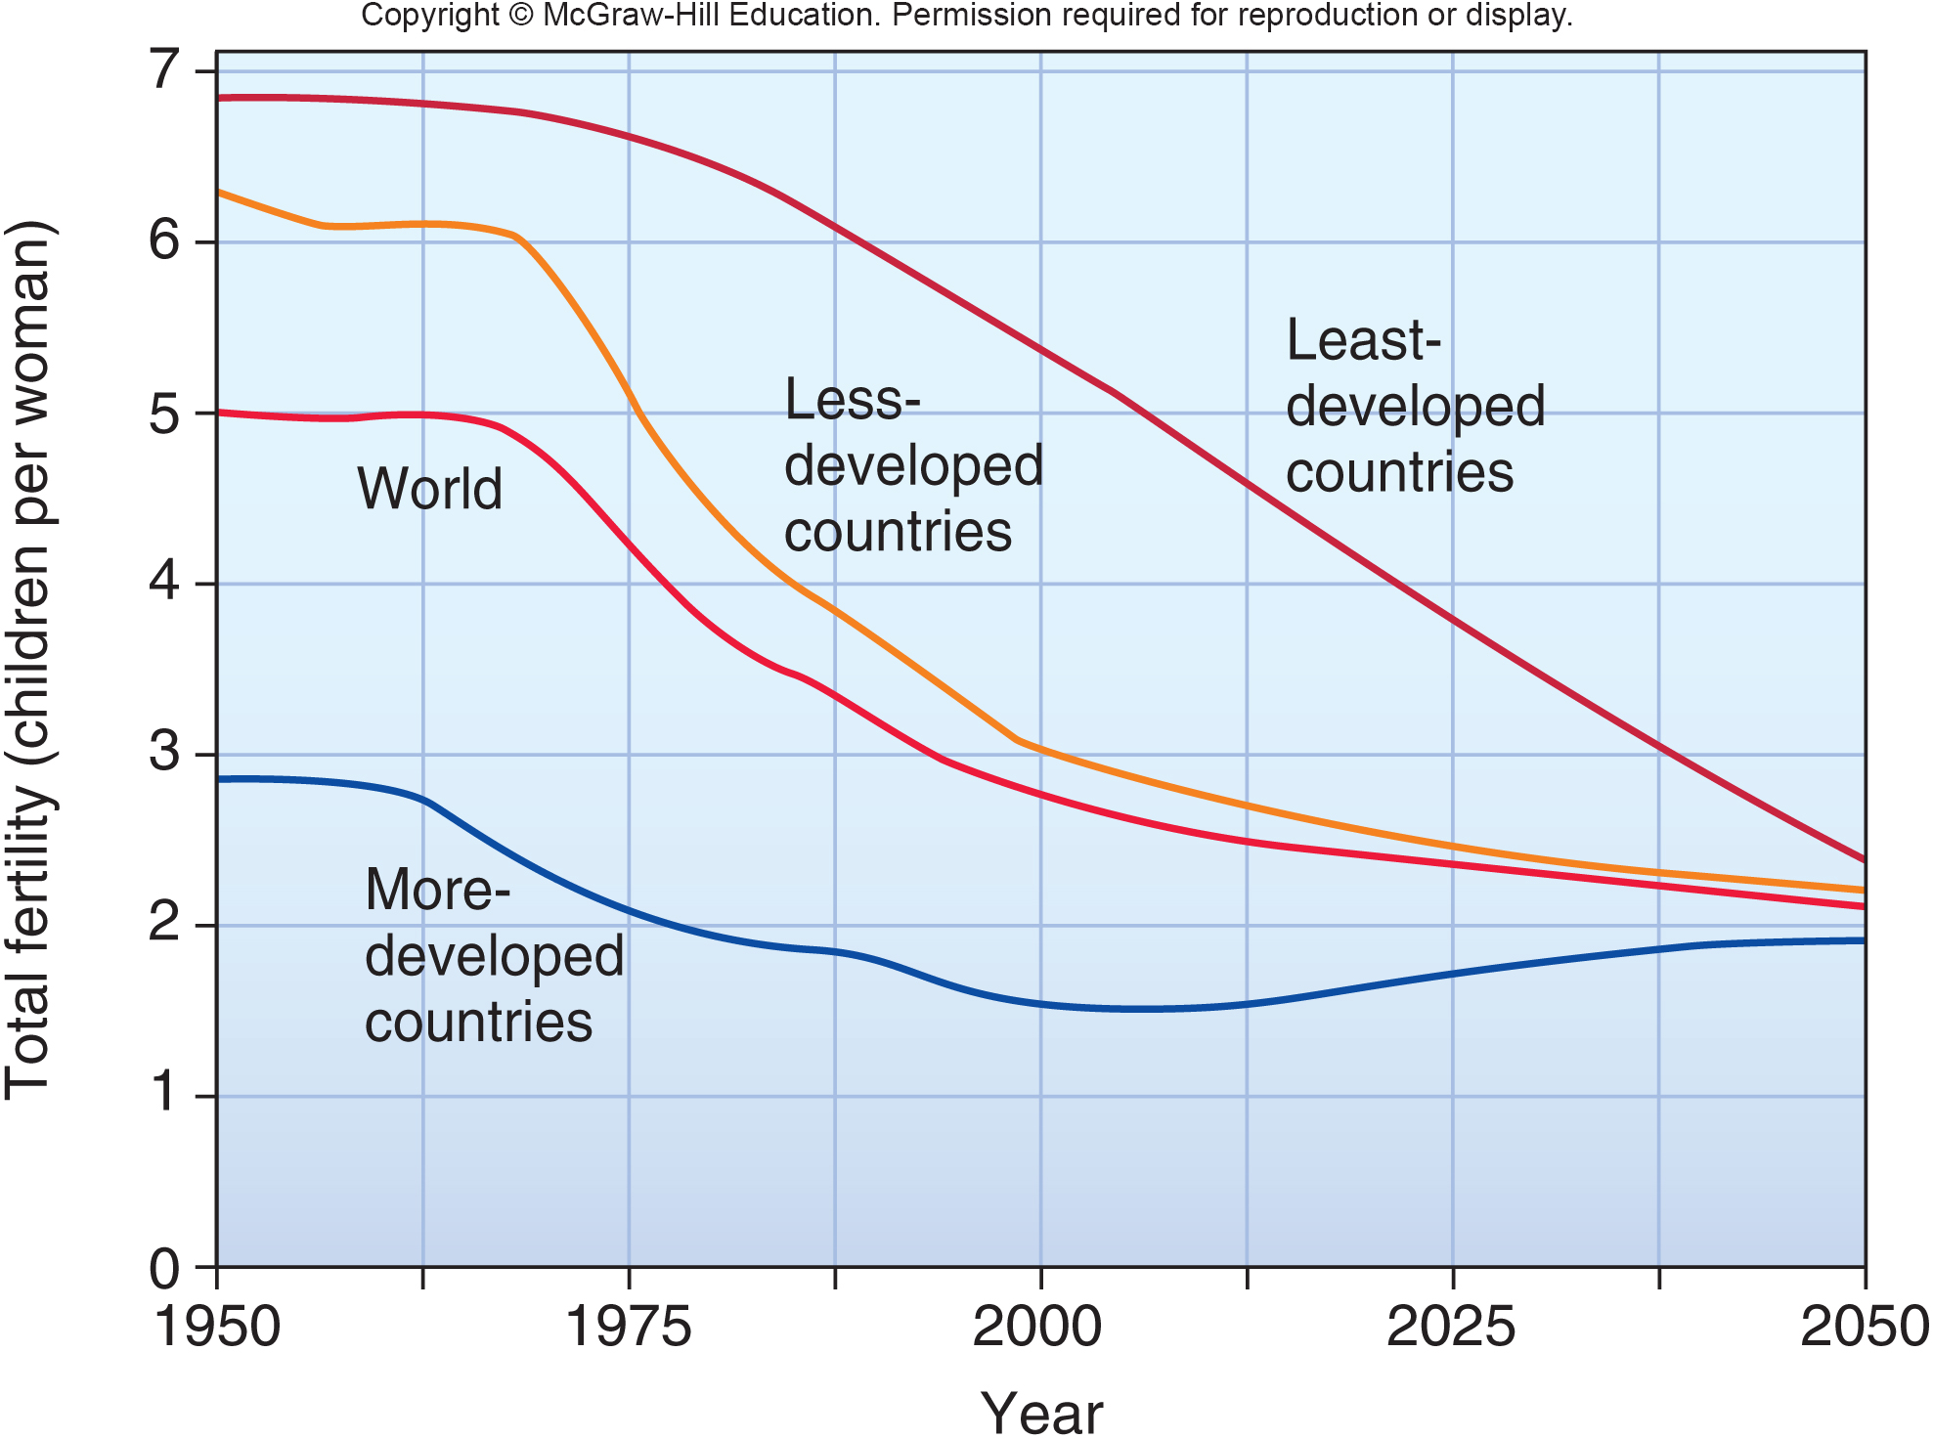
4.4 Fertility Influenced By Culture
The total fertility rate is the number of children born to an average woman in a population during her entire reproductive life.
This rate varies according to many factors.
Notes:
Upper-class women in seventeenth- and eighteenth-century Europe, whose babies were given to wet nurses immediately after birth, sometimes had 25 or 30 pregnancies. The highest recorded total fertility rates for working-class people are among some Anabaptist agricultural groups in North America, who have averaged up to 12 children per woman. In most tribal or traditional societies, food shortages, health problems, and cultural practices limit total fertility to about 6 or 7 children per woman, even without modern methods of birth control.
23

Slide 24
World Fertility Rates are Declining
Zero population growth (ZPG) occurs when births plus immigration in a population just equal deaths plus emigration.
It takes several generations of replacement-level fertility to reach ZPG.
Fertility rates have declined dramatically in most regions of the world over the past 50 years.
While the world as a whole still has an average fertility rate of 2.6, growth rates are now lower than at any time since World War II.
Notes:
Where infant mortality rates are high, the replacement level may be 5 or more children per couple. In the more highly developed countries, however, this rate is usually about 2.1 children per couple because some people are infertile, have children who do not survive, or choose not to have children.
24

Slide 25
Life Expectancy is Rising Worldwide
TABLE 4.2 The World's Largest Countries
2010 | 2010 | 2050 | 2050
COUNTRY | POPULATION (MILLIONS) | COUNTRY | POPULATION (MILLIONS)
China | 1,339 | India | 1,628
India | 1,204 | China | 1,437
United States | 313 | United States | 420
Indonesia | 240 | Nigeria | 299
Brazil | 203 | Pakistan | 295
Pakistan | 178 | Indonesia | 285
Bangladesh | 159 | Bangladesh | 231
Nigeria | 155 | Brazil | 220
Russia | 142 | Dem. Rep. of Congo | 183
SOURCE: Data from the U.S. Census Bureau, 2012.
Life span is the oldest age to which a species is known to survive.
Life expectancy is the average age that a newborn infant can expect to attain in any given society.
Notes:
Worldwide, the average life expectancy rose from about 40 to 67.2 years over the past 100 years. The greatest progress was in developing countries. For example, in 1900 the average Indian man or woman could expect to live about 23 years. A century later, although India had an annual per capita income of only $3,500 (U.S.), the average life expectancy for both men and women had nearly tripled and was very close to that of countries with ten times its income level. Longer lives were due primarily to better nutrition, improved sanitation, clean water, and education, rather than to miracle drugs or high-tech medicine.
25

Slide 26
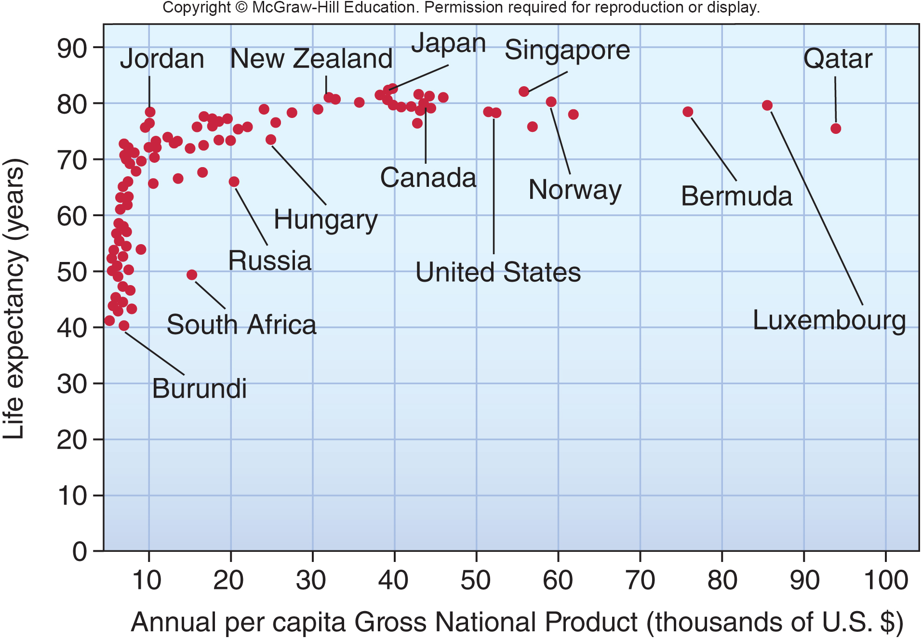
Life Expectancy is Related to Income
Notes:
As incomes rise, so does life expectancy up to about $4,000 (U.S.). Above that amount the curve levels off. Some countries, such as South Africa and Russia, have far lower life expectancies than their GDP would suggest. Jordan, on the other hand, which has only one-tenth the per capita GDP of the United States, actually has a higher life expectancy.

Slide 27
Living Longer has Profound
Social Implications
Age class histograms can show differences between different ages of people in a population and illustrate the social implications of population growth.
These histograms can be used to determine the dependency ratio, the number of nonworking compared with working individuals in a population.
In Niger, for example, each working person supports a high number of children. In the United States, by contrast, a declining working population is now supporting an ever larger number of retired persons.
Notes:
A population growing rapidly by natural increase has more young people than does a stationary population. One way to show these differences is to graph age classes in histograms (fig. 4.10). In Niger, which was growing at a rate of 3.9 percent per year in 2012, about half the population is in the prereproductive category (below age 15). Even if total fertility rates fell abruptly, the total number of births, and the population size, would continue to grow for some years as these young people entered reproductive age (an example of population momentum).
Both rapidly growing countries and slowly growing countries can have a problem with their dependency ratio, or the number of nonworking compared with working individuals in a population. In Niger, for example, each working person supports a high number of children. In the United States, by contrast, a declining working population is now supporting an ever larger number of retired persons.
27

Slide 28
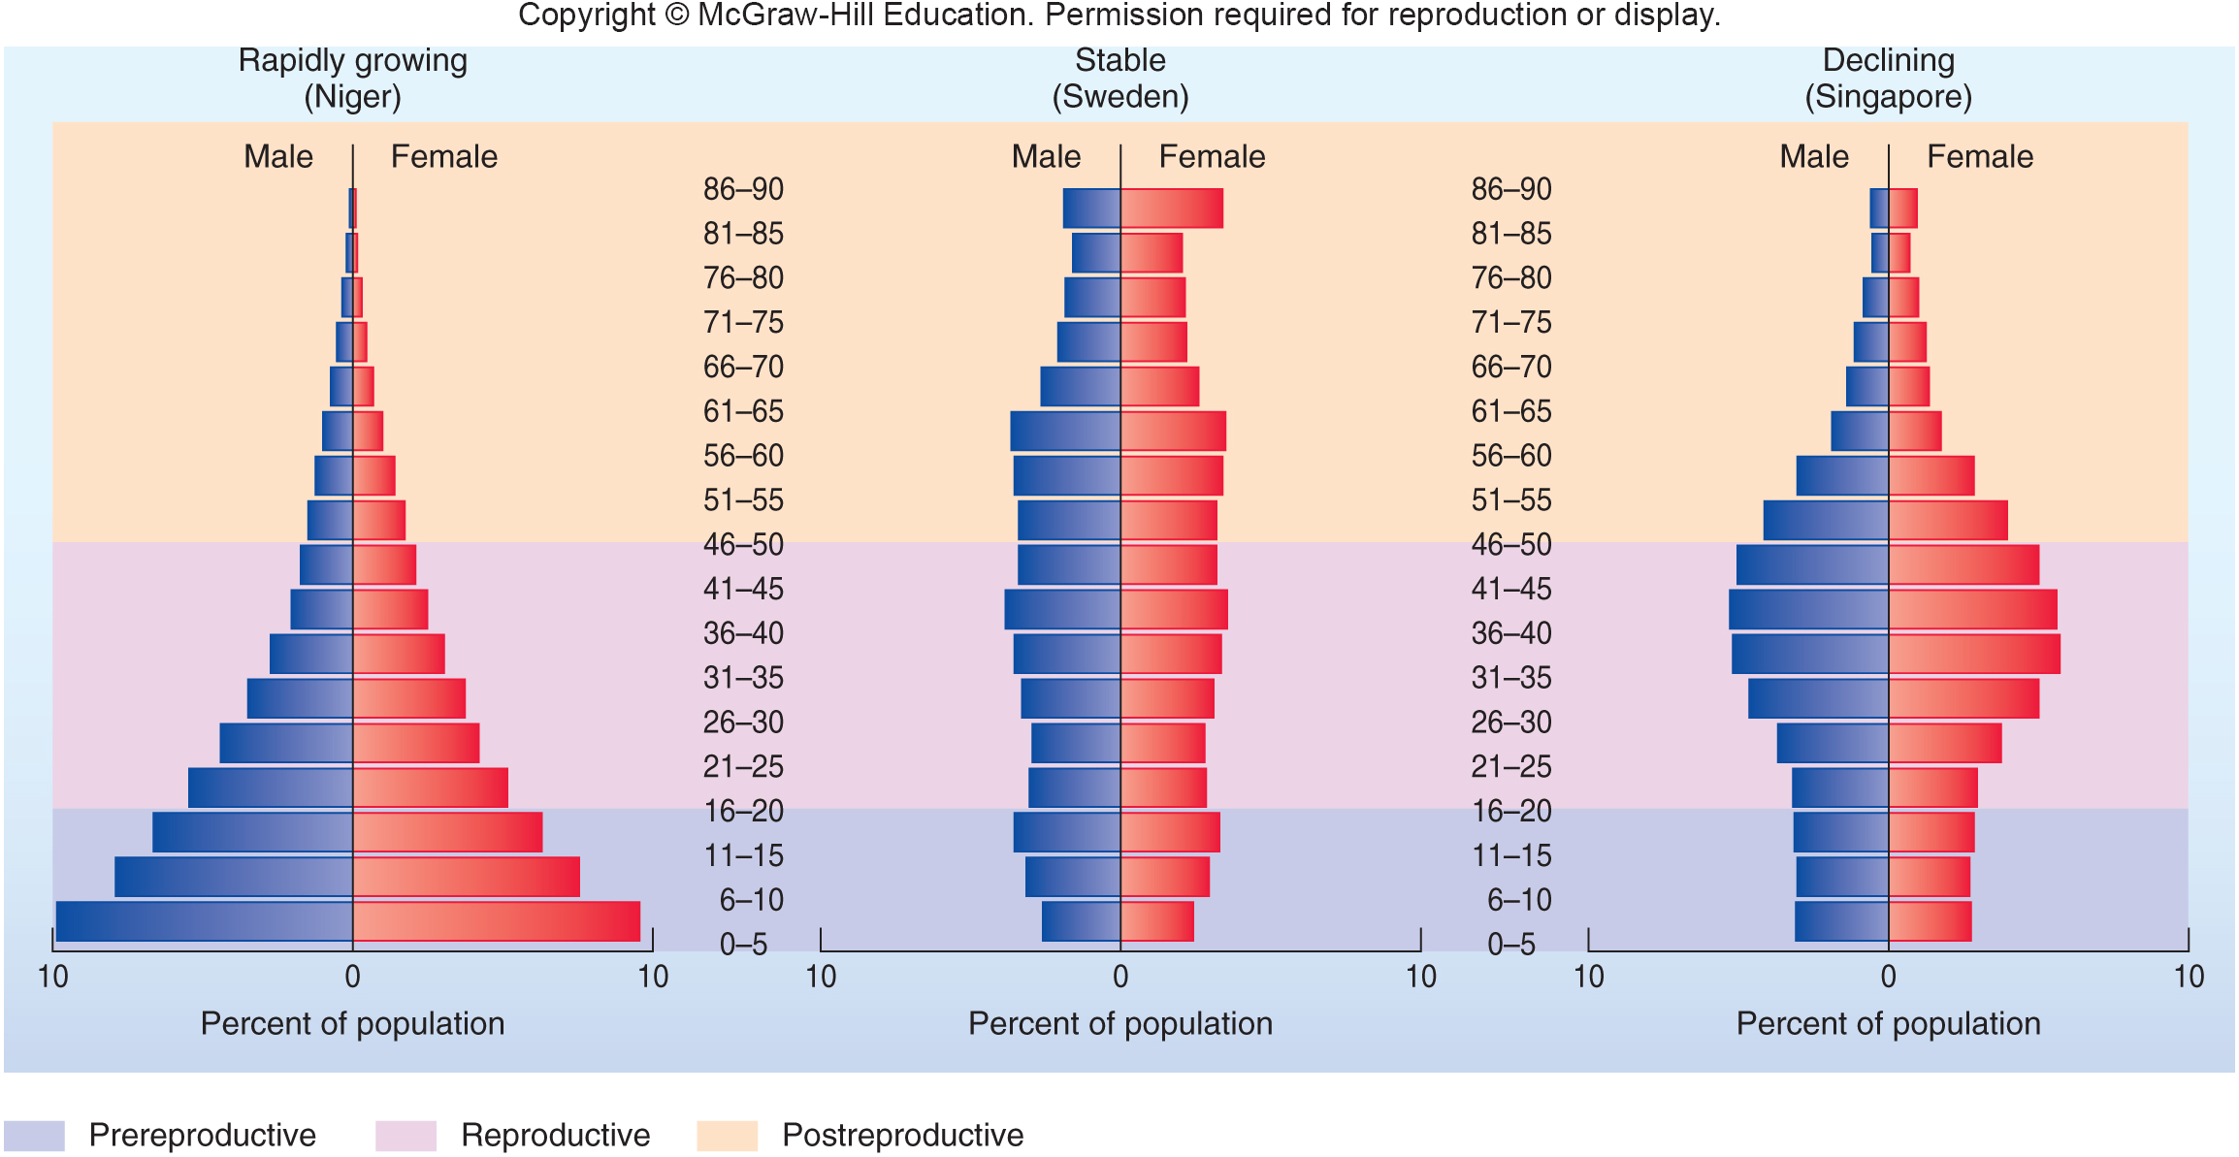
Age Class Histograms
Notes:
The shape of each age-class histogram is distinctive for a population that is rapidly growing (Niger), stable (Sweden), or declining ( Singapore). Horizontal bars represent the percentage of the country’s population in consecutive age classes (0–5 yrs., 6–10 yrs., etc.).
28

Slide 29
4.4 Fertility is Influenced by Culture
A number of social and economic pressures affect decisions about family size which, in turn, affects the population at large. In this section we will examine both positive and negative pressures on reproduction.

Slide 30
People Want Children for Many Reasons
Factors that increase people’s desire to have babies are called pronatalist pressures.
Children may be the only source of support for elderly parents in countries without a social security system.
Often children are valuable to the family not only for future income, but even more as a source of current income and help with household chores.
Society also has a need to replace members who die or become incapacitated.
Notes:
Children can be a source of pleasure, pride, and comfort. They may be the only source of support for elderly parents in countries without a social security system. Where infant mortality rates are high, couples may need to have many children to ensure that at least a few will survive to take care of them when they are old. Where there is little opportunity for upward mobility, children give status in society, express parental creativity, and provide a sense of continuity and accomplishment otherwise missing from life. Often children are valuable to the family not only for future income but even more as a source of current income and help with household chores. In much of the developing world, small children tend domestic animals and younger siblings, fetch water, gather firewood, help grow crops, or sell things in the marketplace (fig. 4.12). Parental desire for children rather than an unmet need for contraceptives may be the most important factor in population growth in many cases.
Society also has a need to replace members who die or become incapacitated. This need often is codified in cultural or religious values that encourage bearing and raising children. Some societies look upon families with few or no children with pity or contempt. The idea of deliberately controlling fertility may be shocking, even taboo. Women who are pregnant or have small children have special status and protection. Boys frequently are more valued than girls because they carry on the family name and are expected to support their parents in old age. Couples may have more children than they really want in an attempt to produce a son.
Male pride often is linked to having as many children as possible. In Niger and Cameroon, for example, men, on average, want 12.6 and 11.2 children, respectively.
30

Slide 31

In Low-tech Agricultural Areas Children are Additional Laborers
Notes:
In rural areas with little mechanized agriculture (a), children are needed to tend livestock, care for younger children, and help parents with household chores. Where agriculture is mechanized (b), rural families view children just as urban families do—helpful, but not critical to survival. This affects the decision about how many children to have.
31

Slide 32
Education and Income Affect the Desire for Children
Highly developed countries
Higher education and personal freedom affect women to not have children.
The desire to spend time and money on other priorities limits the number of children.
Developing countries
Feeding and clothing is minimally expensive, adding one more child is negligible compared to the costs in developed countries.
Notes:
In more highly developed countries, many pressures tend to reduce fertilityWhen women have opportunities to earn a salary, they are less likely to stay home and have many children. Not only do many women find the challenge and variety of a career attractive, but the money that they earn outside the home becomes an important part of the family budget. Thus, education and socioeconomic status are usually inversely related to fertility in richer countries.
In less-developed countries, where feeding and clothing children can be a minimal expense, adding one more child to a family usually doesn’t cost much. By contrast, raising a child in a developed country can cost hundreds of thousands of dollars by the time the child finishes school and is independent. Under these circumstances, parents are more likely to choose to have one or two children on whom they can concentrate their time, energy, and financial resources.
32

Slide 33
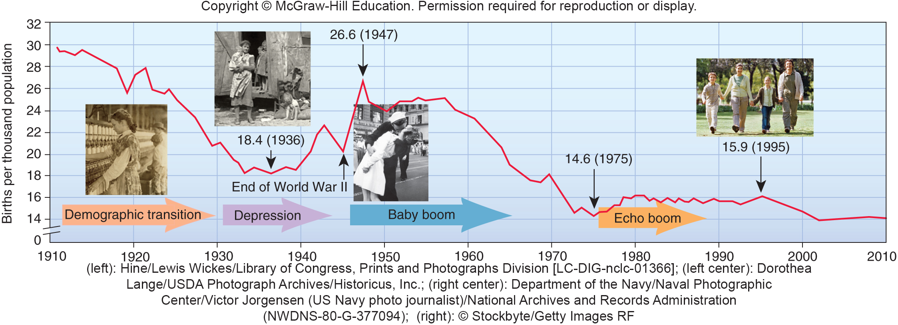
4.5 A Demographic Transition Can
Lead to Stable Population Size
Demographic transition is a typical pattern of falling death rates and birth rates due to improved living conditions that usually accompanies economic development.
Notes:
Birth rates in the United States, 1910–2000. The falling birth rate from 1910 to 1929 represents a demographic transition from an agricultural to an industrial society. The baby boom following World War II lasted from 1945 to 1965. A much smaller “echo boom” occurred around 1980 when the baby boomers started to reproduce.
33

Slide 34
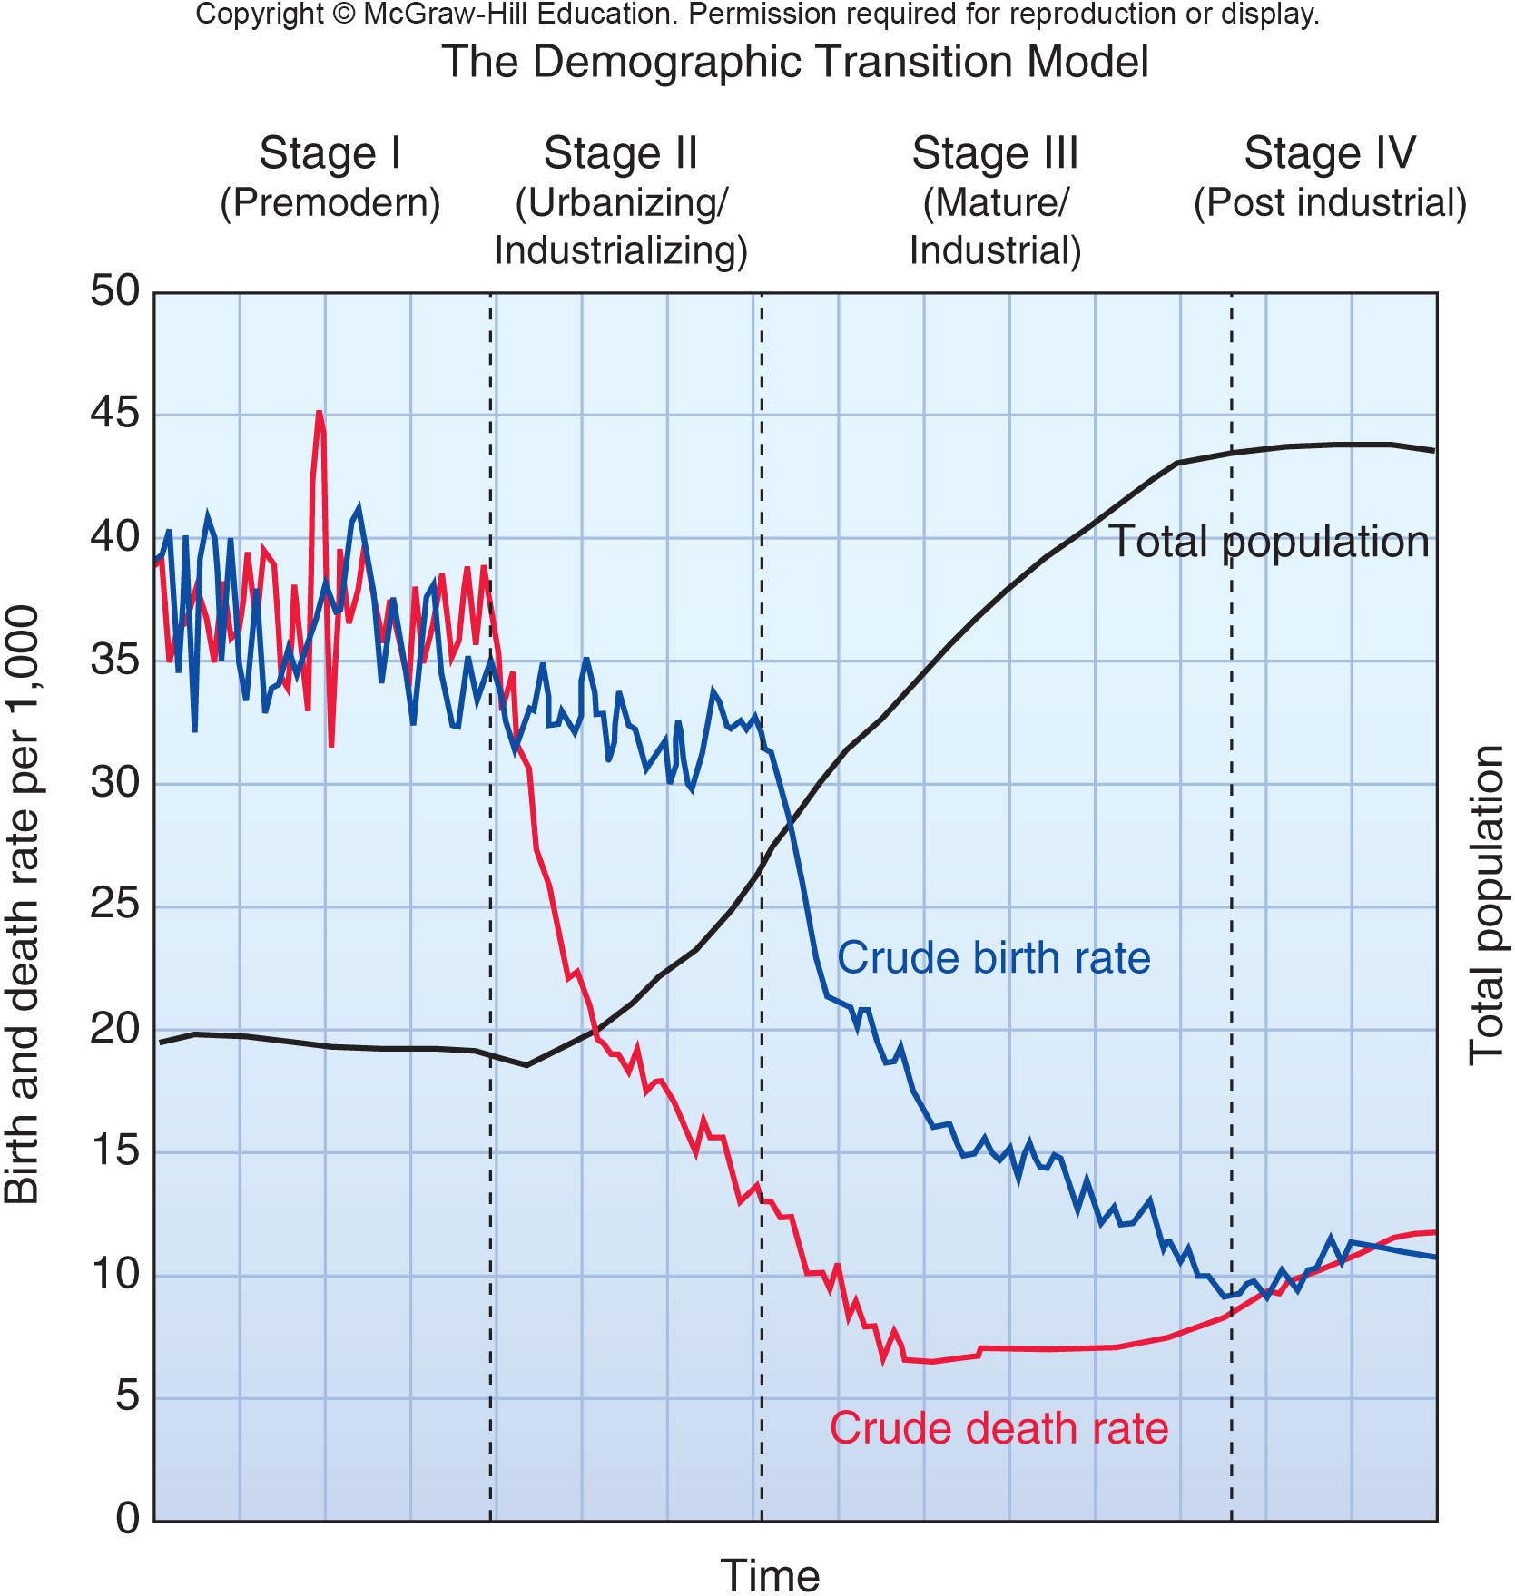
Stage I
Economic and social conditions change
mortality and births.
Stage I represents the conditions in a premodern society.
Notes:
Stage I in figure 4.14 represents the conditions in a premodern society. Food shortages, malnutrition, lack of sanitation and medicine, accidents, and other hazards generally keep death rates in such a society around 30 per 1,000 people. Birth rates are correspondingly high to keep population densities relatively constant.
34

Slide 35
Stage II
Economic development in Stage II brings better jobs, medical care, sanitation, and a generally improved standard of living, and death rates often fall very rapidly.
Notes:
Economic development in Stage II brings better jobs, medical care, sanitation, and a generally improved standard of living, and death rates often fall very rapidly. Birth rates may actually rise at first as more money and better nutrition allow people to have the children they always wanted. In a couple of generations, however,
birth rates fall as people see that all their children are more likely to survive and that the whole family benefits from concentrating more resources on fewer children.
35

Slide 36
Stage III
Note that populations grow rapidly during Stage III when death rates have already fallen but birth rates remain high.
Notes:
Depending on how long it takes to complete the transition, the population may go through one or more rounds of doubling before coming into balance again.
36

Slide 37
Stage IV
Stage IV represents conditions in developed countries, where the transition is complete and both birth rates and death rates are low, often a third or less than those in the predevelopment era.
Notes:
The population comes into a new equilibrium in this phase, but at a much larger size than before. Most of the countries of northern and western Europe went through a demographic transition in the nineteenth or early twentieth century similar to the curves shown in figure 4.14. In countries such as Italy, where fertility levels have fallen below replacement rates, there are now fewer births than deaths, and the total population curve has started to decline.
37

Slide 38
Many Countries are in a
Demographic Transition
Some demographers claim that a demographic transition already is in progress in most developing nations.
They believe that a lag between falling death and birth rates may hide this for a time but that the world population should stabilize sometime in this century.
Some countries have had remarkable success in population control. In Thailand, China, and Colombia, for instance, total fertility dropped by more than half in 20 years. Morocco, Jamaica, Peru, and Mexico all have seen fertility rates fall by 30 to 40 percent.
Notes:
Some countries have had remarkable success in population control. In Thailand, China, and Colombia, for instance, total fertility dropped by more than half in 20 years. Morocco, Jamaica, Peru, and Mexico all have seen fertility rates fall by 30 to 40 percent in a single generation. Surprisingly, one of the most successful family planning advances in recent years has been in Iran, a predominantly Muslim country.
38

Slide 39
Two Ways to Complete the Demographic Transition (1)
The Indian states of Kerala and Andra Pradesh exemplify two very different approaches to regulating population growth.
In Kerala, providing a fair share of social benefits to everyone is seen as the key to family planning.
The leaders of Andra Pradesh, on the other hand, have adopted a strategy of aggressively emphasizing birth control, rather than promoting social justice.
Both states have slowed population growth significantly.
Notes:
The Indian states of Kerala and Andra Pradesh exemplify two very different approaches to regulating population growth. In Kerala, providing a fair share of social benefits to everyone (socialism) is seen as the key to family planning. This social justice strategy assumes that the world has enough resources for everyone, but inequitable social and economic systems cause maldistributions of those resources. Hunger, poverty, violence, environmental degradation, and overpopulation are symptoms of a lack of justice, rather than a lack of resources. Although overpopulation exacerbates other problems, a focus on growth rates alone encourages racism and hatred of the poor. Proponents of this perspective argue that richer people should recognize the impacts their exorbitant consumption has on others (fig. 4.15).
The leaders of Andra Pradesh, on the other hand, have adopted a strategy of aggressively emphasizing birth control, rather than promoting social justice. This strategy depends on policies, similar to those in China, that assume providing carrots (economic rewards for reducing births) along with sticks (mandates for limiting
reproduction together with punishment for exceeding limits) are the only effective ways to regulate population size.
Both states have slowed population growth significantly. And though they employ very different strategies, both aim to avoid a “ demographic trap” in which rapidly growing populations exceed the sustainable yield of local forests, grasslands, croplands, and water resources.
39

Slide 40

Two Ways to Complete the Demographic Transition (2)
Notes:
Population growth, resulting from high birth rates, has important impacts on resource consumption. But small, wealthy families consume far more resources per person, usually sourced from around the globe. Many people debate which impact is more important, but ultimately there are good reasons for reducing both family size and consumption rates.

Slide 41
Improving Women’s Lives Helps
Reduce Birth Rates
A broad consensus reached by the 180 participating countries at the 1994 International
Conference on Population and Development agreed that the following are necessary to help slow population growth:
responsible economic development
education and increased women’s rights
high-quality health care (including family planning services)
Notes:
The 1994 International Conference on Population and Development in Cairo, Egypt, supported this approach to population issues. A broad consensus reached by the 180 participating countries agreed that responsible economic development, education, and women’s rights, along with high-quality health care (including family planning services), must be accessible to everyone if population growth is to be slowed. Child survival is one of the most critical factors in stabilizing population. When infant and child mortality rates are high, as they are in much of the developing world, parents tend to have high numbers of children to ensure that some will survive to adulthood. There has never been a sustained drop in birth rates that was not first preceded by a sustained drop in infant and child mortality.
41

Slide 42
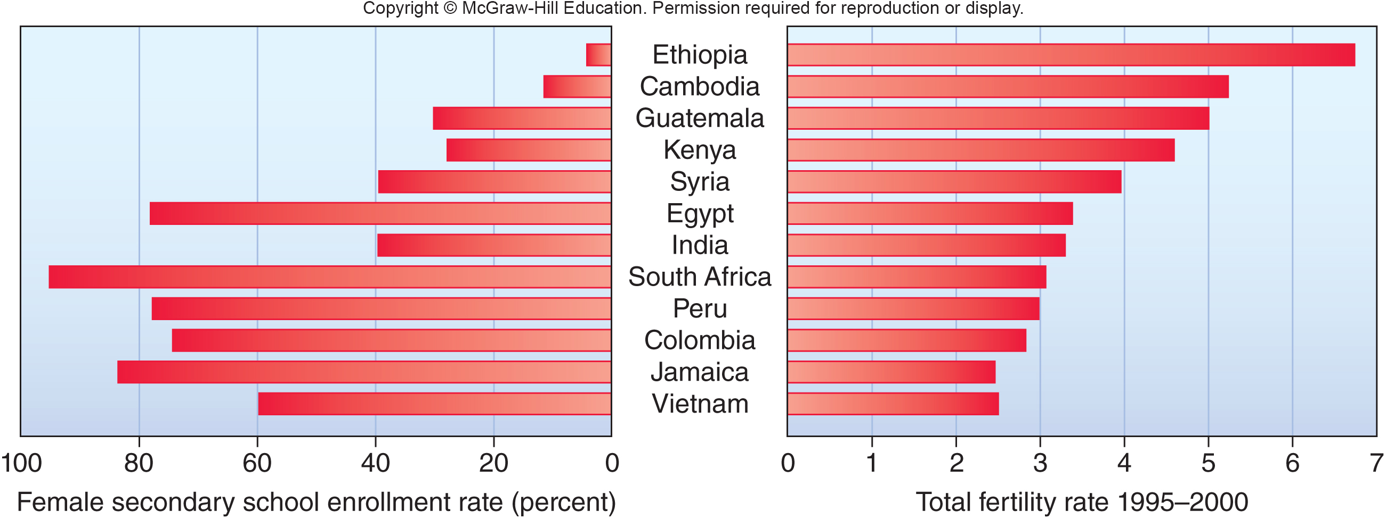
Total Fertility Declines as Women’s Education Increases

Slide 43
4.6 Family Planning Gives Us Choices
Family planning allows couples to determine the number and spacing of their children.
Birth control usually means any method used to reduce births including celibacy, delayed marriage, contraception, and methods that prevent embryo implantation and other methods like induced abortions.
Notes:
Family planning doesn’t necessarily mean fewer children—people could use family planning to have the maximum number of children possible—but it does imply that the parents will control their reproductive lives and make rational, conscious decisions about how many children they will have and when those children will be born, rather than leaving it to chance. As the desire for smaller families becomes more common, birth control often becomes an essential part of family planning.
43

Slide 44
Humans Have Always
Regulated Their Fertility
The high human birth rate of the last two centuries is not the norm, compared to previous millennia of human existence.
Evidence suggests that people in every culture and every historic period used a variety of techniques to control population size.
These have included taboos against intercourse while breast-feeding, celibacy, folk medicines, abortion, and infanticide.
Notes:
Studies of hunting and gathering people, such as the !Kung, or San, of the Kalahari Desert in southwest Africa, indicate that our early ancestors had stable population densities, not because they killed each other or starved to death regularly but because they controlled fertility. For instance, San women breast-feed children for three or four years. When calories are limited, lactation depletes body fat stores and suppresses ovulation. Coupled with taboos against intercourse while breast-feeding, this is an effective way of spacing children. (However, breast-feeding among well-nourished women in modern societies doesn’t necessarily suppress ovulation or prevent conception.) Other ancient techniques to control population size include celibacy, folk medicines, abortion, and infanticide. We may find some or all of these techniques unpleasant or morally unacceptable, but we shouldn’t assume that other people are too ignorant or too primitive to make decisions about fertility.

Slide 45
Today There are Many Options
More than 100 new contraceptive methods are now being studied, and some appear to have great promise to have great promise.
Recently the U.S. Food and Drug Administration approved five new birth control products. Four of these use various methods to administer female hormones that prevent pregnancy.
Other methods, such as vaccines for women or injections for men, are years away from use.
Notes:
Nearly all are biologically based (e.g., hormonal) rather than mechanical (e.g., condom, IUD). Other methods are years away from use, but take a new direction entirely. Vaccines for women are being developed that will prepare the immune system to reject the hormone chorionic gonadotropin, which maintains the uterine lining and allows egg implantation, or that will cause an immune reaction against sperm. Injections for men are focused on reducing sperm production, and have proven effective in mice.
45

Slide 46
4.7 What Kind of Future are We
Creating Now?
Most demographers believe that world population will stabilize sometime during this century.
When we reach that equilibrium, the total number of humans is likely to be somewhere around 8 to 10 billion.
The United Nations Population Division projects four possible population scenarios.
Notes:
Because there’s often a lag between the time when a society reaches replacement birth rate and the end of population growth, we are deciding now what the world will look like in a hundred years. How many people will be in the world a century from now?

Slide 47
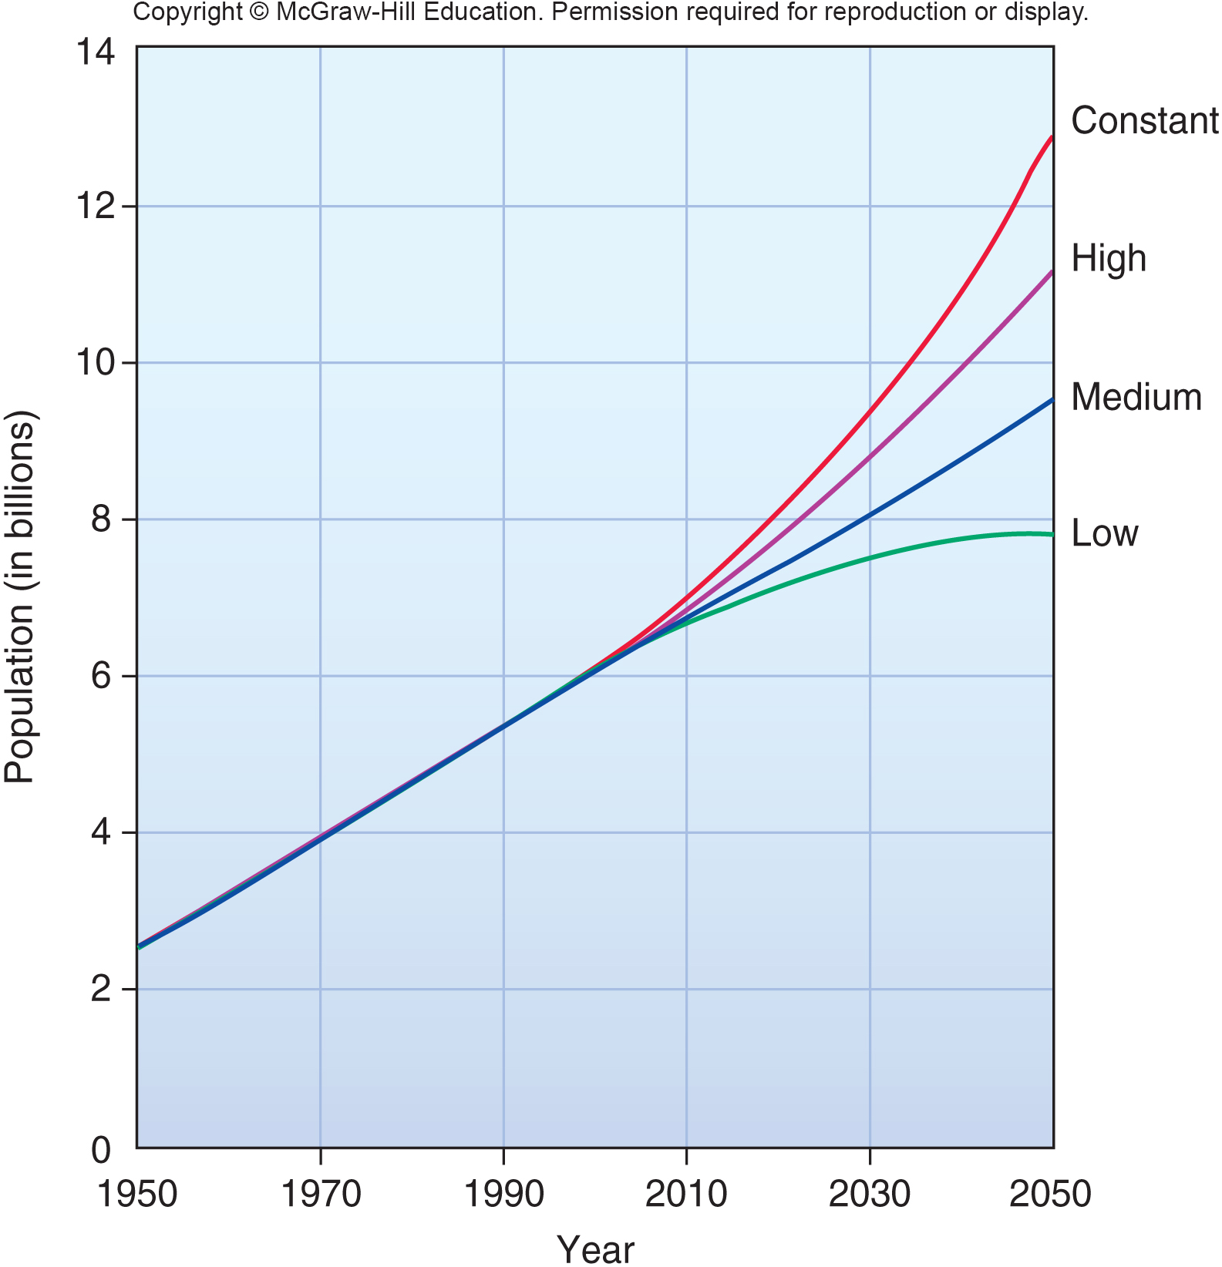
World Population Projections
Notes:
The optimistic (low) projection suggests that world population might stabilize by about 2030 and then drop back below current levels. This doesn’t seem likely. The medium projection shows a population of about 9 billion in 40 years, while the high projection would reach 12 billion by midcentury.
47

Slide 48
Successful Family Planning Programs Often Require Significant Societal Changes
Among the most important of these are:
Improved social, educational, and economic status for women.
Improved status for children.
Acceptance of calculated choice as a valid element in life in general and in fertility in particular.
Social security and political stability that give people the means and the confidence to plan for the future.
The knowledge, availability, and use of effective and acceptable means of birth control.
Notes:
(1) improved social, educational, and economic status for women (birth control and women’s rights are often linked); (2) improved status for children (fewer children are born if they are not needed as a cheap labor source); (3) acceptance of calculated choice as a valid element in life in general and in fertility in particular (the belief that we have no control over our lives discourages a sense of responsibility); (4) social security and political stability that give people the means and the confidence to plan for the future; and (5) the knowledge, availability, and use of effective and acceptable means of birth control. Concerted efforts to bring about these types of societal changes can be effective. Twenty years of economic development and work by voluntary family planning groups in Zimbabwe, for example, have lowered total fertility rates from 8.0 to 5.5 children per woman on average. Surveys show that desired family sizes have fallen nearly by half (9.0 to 4.6) and that nearly all women and 80 percent of men in Zimbabwe use contraceptives.
48

Slide 49
Brazil Gives Us Hope For the Future
Already, nearly half the world population lives in countries where the total fertility rate is at or close to the replacement rate.
The example of Brazil gives us hope that with rising standards of living, population growth will spontaneously slow without harsh government intervention.

Slide 50
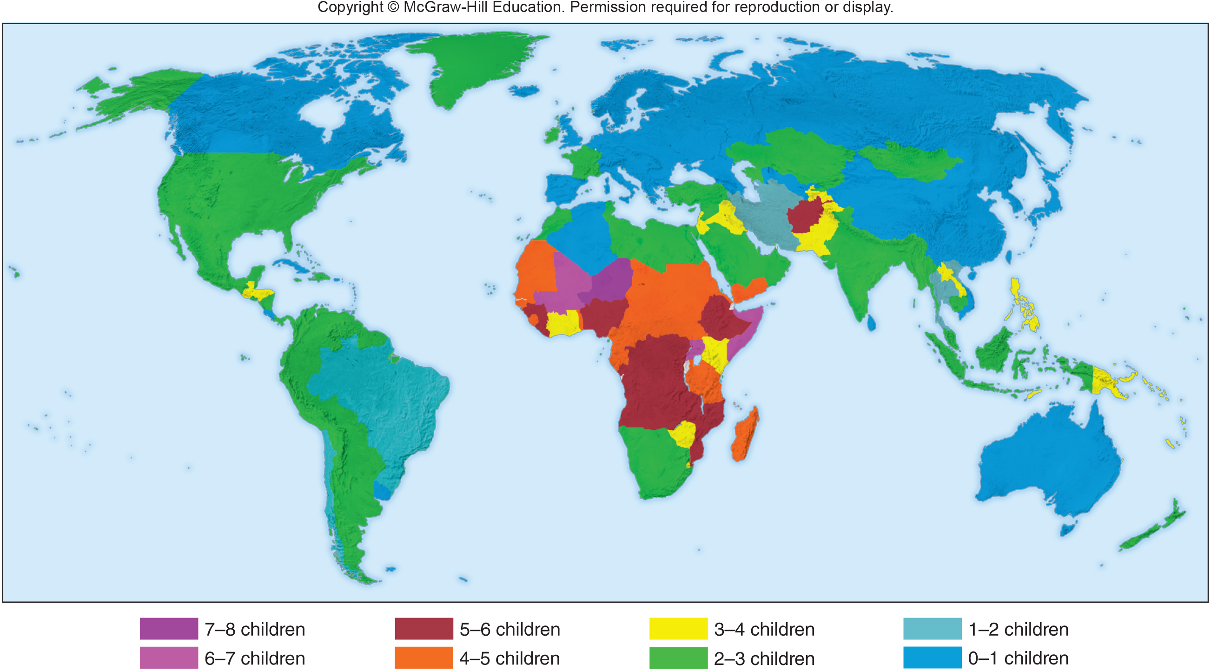
Fertility Rates by Country
Notes:
Fertility rates by country. Although average fertility in the United States is currently 2.06, it’s below the replacement rate of 2.1 children per woman.

Slide 51
Conclusion
A few decades ago, we were warned that a human population explosion was about to engulf the world.
However, birth rates have fallen, however, almost everywhere, and most demographers now believe that we will reach an equilibrium around 9 billion people in about 2050.
How, or if, we should carry out family planning and utilize birth control remains controversial.
How many humans our planet can support on a long-term basis also remains a vital question.

